Slide 1
Terrestrial and Aquatic Biomes

Slide 2
To Review
Organism- lowest organizational level, one individual of a species
Population- group of organisms that share the same space at the same time
Community- group of populations that share the same space at the same time
Ecosystem- a community and all of the abiotic factors that affect it (note the introduction of the abiotic factors here)

Slide 3
To Review
Biome- large grouping of ecosystems that have the same climate and similar groups of communities
Biosphere- all of the regions on Earth that can support life, can extend from many km above or below the Earth’s surface AS LONG AS IT SUPPORTS LIFE

Slide 4
Climate
Climate describes and area’s average weather conditions, including temperature and precipitation
Latitude has a major effect of climate
If latitude were the ONLY abiotic factor involved in climate, what would happen?
We would see biomes spread in equal bands encircling the Earth.

Slide 5
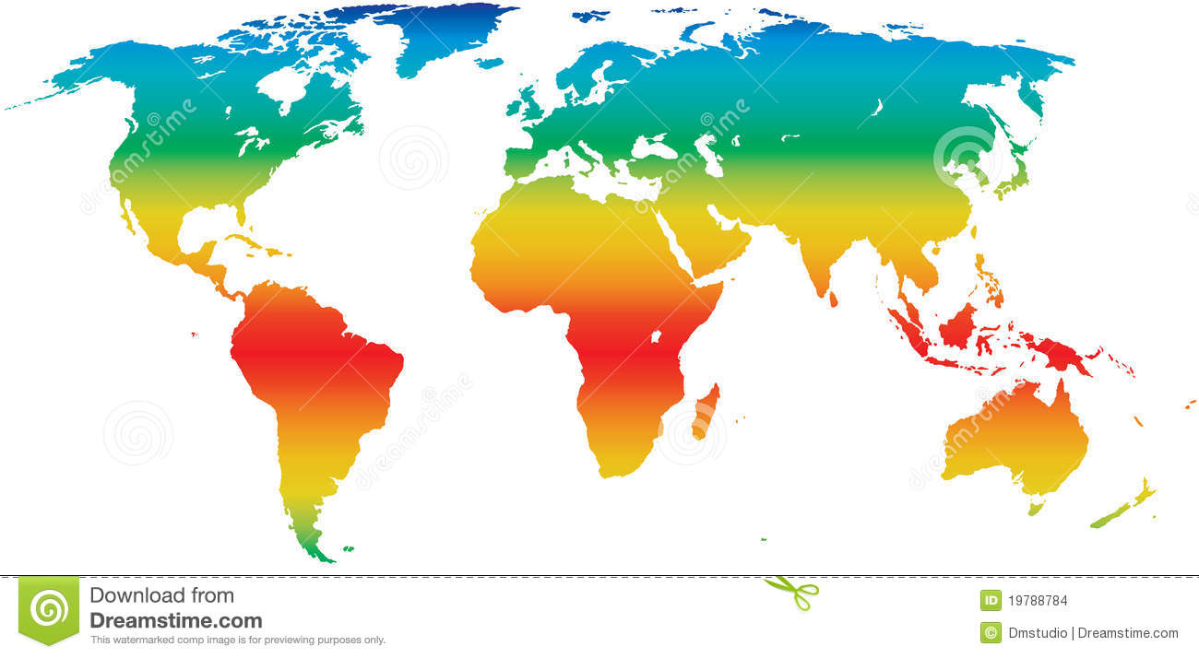

Slide 6
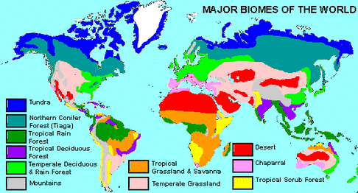

Slide 7
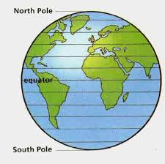
Effects of Latitude on Climate
Weather - a condition of
the atmosphere at a specific
place and time
Latitude - plays an impt
role in weather patterns &
effects it has on organisms
in different parts of the world

Slide 8
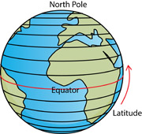
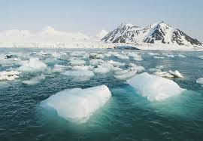
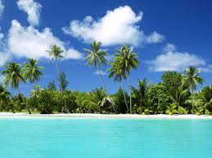
Latitude
Latitude - distance of any point of the surface of the Earth north or south from the equator
Light from the sun strikes the Earth more directly at the equator than at the poles
What is the result of this phenomenon?

Slide 9
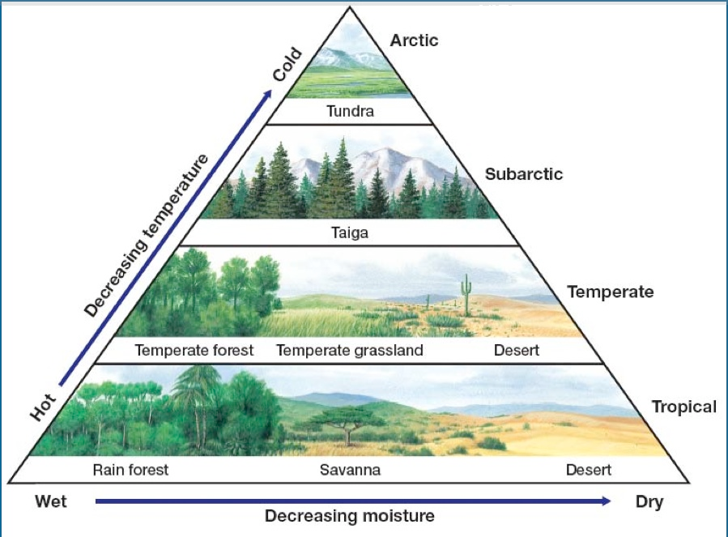

Slide 10
Major Land Biomes
Biomes are classified by
Plants
Temperature
Precipitation
Animal species
9 major biomes and 2 other types of terrestrial areas

Slide 12
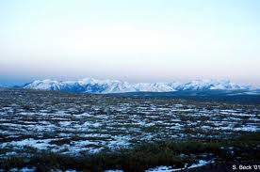
Major Land Biomes Tundra
Treeless biome
layer of permanent frozen soil below the surface = permafrost
Ground thaws a few centimeters each summer but the constant cycling does not allow trees to take root
Shallow-rooted plants grow
animals have adapted to life in the tundra

Slide 13
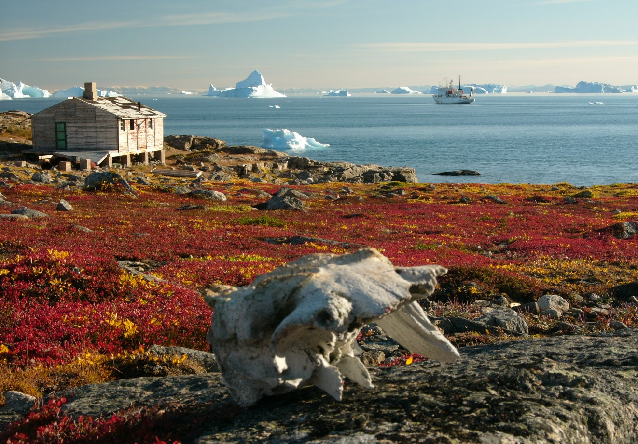
Major Land Biomes Tundra
South of polar ice caps in the Northern Hemisphere
Low precipitation and low temperatures
Short grasses and shrubs
Caribou, polar bears, birds, wolves, salmon, trout, insects
Soggy summers with thawing
Permafrost
Cold and dark much of the year

Slide 14
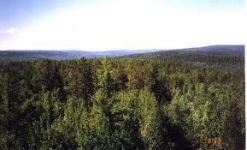
Major Land Biomes Taiga Forest
Broad band of dense evergreen forests
Also known as coniferous forest
summers are longer-ground remains warmer than the tundra
Northern parts of N. America, Europe and Asia
Low amount of rain and low temperatures
Spruce and fir trees, small shrubs
Moose, beavers, deer, mountain lions, birds
Summers are short and wet
winters are long, cold and dry

Slide 15
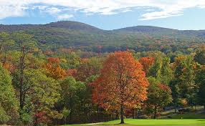
Major Land Biomes Temperate Forest
Composed mainly of broad-leaved, deciduous trees
Fallen leaves return nutrients to the soil
Warm temperatures in spring and summer allow for the growth cycle to restart
Covers much of SE Canada, E US, most of Europe, Asia and Australia
Moderate rainfall
Cold winters and hot summers (4 seasons)
Oak, beech, maple trees
Rabbits, squirrels, bears, foxes, deer, birds

Slide 16
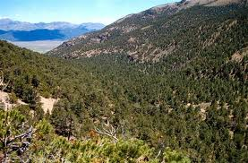
Major Land Biomes Chaparral
Found in areas with less rainfall than temperate forests
Dominated by shrubs
Around Mediterranean Sea, W coasts of N & S America, S. Africa and Australia
Moderate rainfall, cool winters and hot summers
Evergreen shrubs, corn oak
Foxes, birds, snakes, butterflies, coyotes, lizards

Slide 17
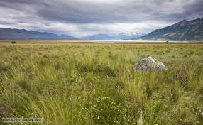
Major Land Biomes Temperate Grassland
Fertile soil-supports a thick cover of grasses
Drought, fires and grazing animals prevent it from becoming a forest
Also called savannahs & prairies
Low to moderate rainfall
Cold winters, hot summers with fires
N & S America, Asia, Africa, Australia
Grasses and herbs
Gazelles, bison, snakes, deer, horses, wolves, quail, birds……

Slide 18
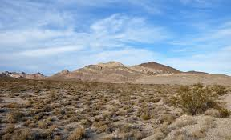
Major Land Biomes Desert
Any area where the annual rate of evaporation exceeds the annual rainfall amount
A wide variety of plants and animals despite little rainfall
Exist on every continent except Europe
Little to no rain, temperatures vary with sunlight (sand can’t hold heat well)
Cacti, Joshua trees, succulents
Lizards, bobcats, birds, rats, antelope

Slide 19
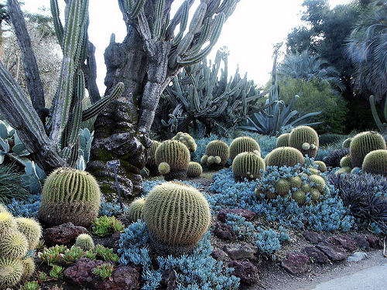
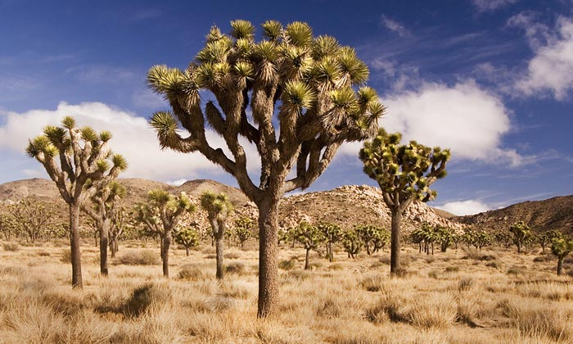

Slide 20
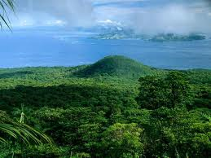
Major Land Biomes Tropical Rainforest
Most diverse of all land biomes
Tall, broad-leaved trees
Heavy mosses, ferns and orchids
Thick understory of creeping plants, ferns and shrubs

Slide 21
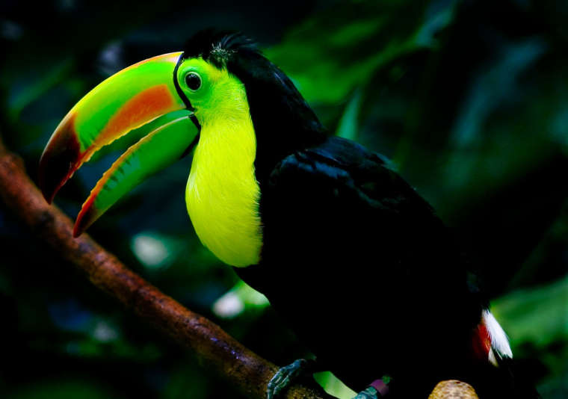
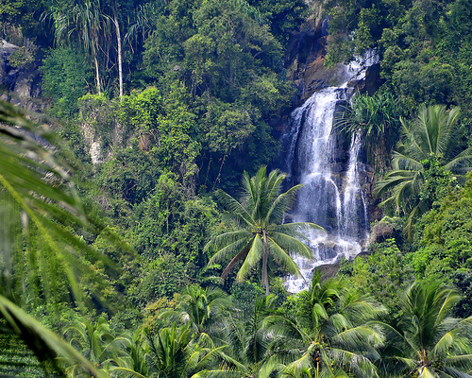
Major Land Biomes Tropical Rainforest
Central and S. America, S. Asia, W. Africa
Heavy rainfall all year
Hot, wet and humid
Broadleaf evergreens, bamboo, sugar cane
Chimpanzees, bats, toucans, cobra snakes, elephants, sloths

Slide 22
Reflection
Find a partner with a different biome
Share with your partner one organism from your biome, discussing adaptations that help it better survive in your biome
Now, place your organism in their biome
How well would your organism survive?
What adaptations might help it? Hurt it?
What new adaptations would your organism need to survive in its new habitat?

Slide 23
Adaptations

Slide 24
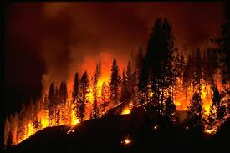
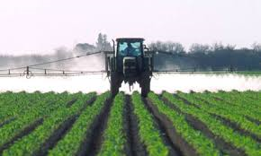
How do ecosystems change?
What are some things that may cause an ecosystem to change?
Natural Disasters
Human Impacts

Slide 25
How do ecosystems change?
Ecosystems are constantly changing
A forest may have been a shallow lake a thousand years ago
Mosses, shrubs, and small trees cover the concrete of a demolished city building
A dead tree falls and lets sunlight reach the forest floor→ causes some seeds to germinate, flowers grow

Slide 26
Ecological Succession
Those are all examples of ecological succession
It is a gradual process of change and replacement of some or all of the species in a community
Each new community that arises makes it harder for the previous community to survive

Slide 27
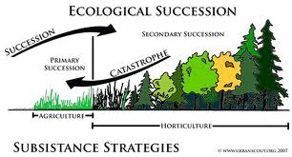

Slide 28
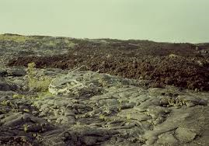
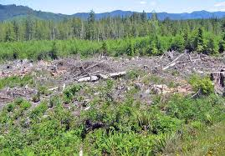
Ecological Succession
Primary Succession
Secondary Succession
Type of succession that occurs on a surface where no ecosystem existed before
Growth on rocks or sand dunes
Type of succession that occurs on a surface where an ecosystem has previously existed
Growth were the ecosystem has been disrupted or disturbed by humans, animals or natural disasters

Slide 29
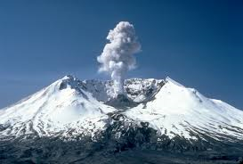
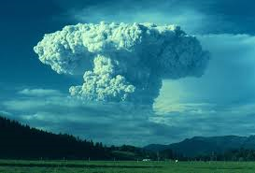
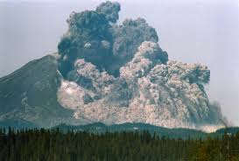
Secondary Succession

Slide 30
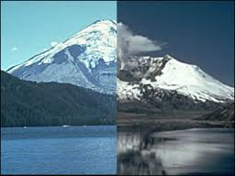

Slide 31
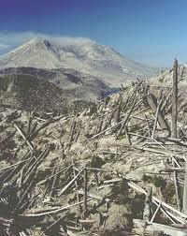
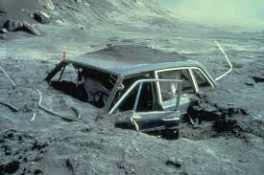
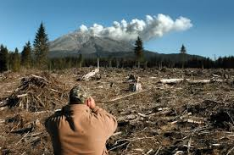
Secondary Succession

Slide 32
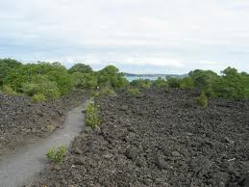
Secondary Succession
Mount St. Helens erupted in 1980 in Washington
44,460 acres of forest burned and flattened by force of hot ash and volcanic debris
Eventually new plants were able to grow and colonize the debris
Old-field succession

Slide 33
Secondary Succession
Pioneer species- the first organisms to colonize any newly available area and begin the process of ecological succession
Over time, a pioneer species will make the new area habitable for other species
Eventually, it will form a stable community
Climax community- the final and stable community

Slide 34
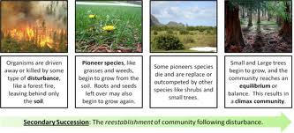
Secondary Succession
Even though a climax community will continue to change in small ways, this type of community will remain the same through time if it is not disturbed

Slide 35
Primary Succession
Occurs on new islands created by volcanic eruptions, in areas exposed when a glacier retreats or on any other surface that has not previously supported life
Much slower than secondary succession because it may take hundreds to thousands of years to produce fertile soil naturally

Slide 36
Primary Succession
The first pioneer species to colonize the bare rock will probably be bacteria and lichens, both of which can live without soil
Lichens are extremely important to succession→is a cross of a fungus and an alga
Alga photosynthesizes, and the fungus absorbs nutrients from rocks and holds water
Together, they break down the rock→ soil

Slide 37
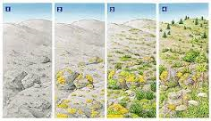
Primary Succession
As the lichens and bacteria die, the remains add nutrients and mass to the growing pile of soil
Thus, fertile soil forms from the broken rock (minerals), decaying organisms (nutrients), water and air

Slide 38
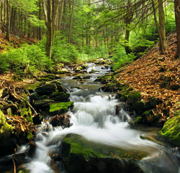
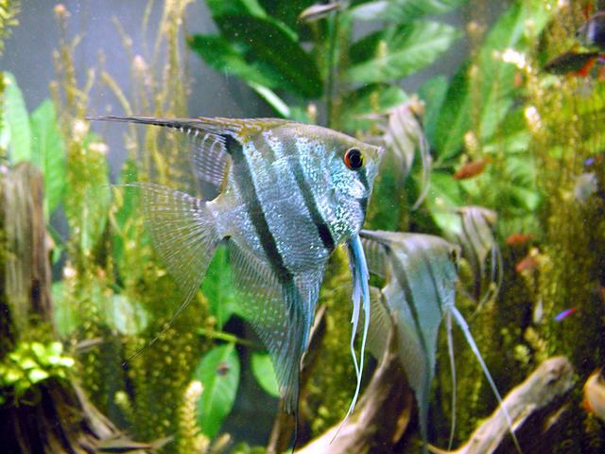
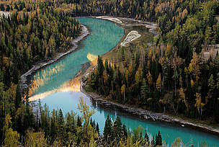
Aquatic Ecosystems

Slide 39
Aquatic Ecosystems
Defined by the abiotic factors that affect it
What are some aquatic ecosystems that you can think of?
What are some abiotic factors that may change, or affect the ecosystem?

Slide 40
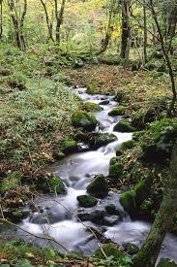
Freshwater Ecosystems
Major ecosystems include ponds, streams, lakes, rivers and wetlands
Plants and animals here are adapted to low salinity levels and are unable to survive in high salt concentration
2.5% of all water on earth is fresh water
- 68.9% of that is trapped in glaciers
- 30.8% is in groundwater
- 0.3% is found in lakes, rivers ponds etc.

Slide 41
Aquatic Ecosystems
Name some large bodies of water that you are familiar with?
Lakes, rivers, oceans- local, regional or across the globe
Scientists recognize the importance of water because of the biological communities that the water supports
3 main types of aquatic ecosystems
1. fresh water
2.marine
3.transitional

Slide 42
Aquatic Ecosystems Rivers and Streams
Water flows in one direction
- slope of landscape determines the speed and direction
of water flow
- river gets wider, water gets warmer and slower as it gets to
more level ground
Characteristics of rivers/streams change during the journey from the source to the mouth
- wind stirs up surface of water→ adds O2 to water
- interaction with land causes erosion→ adds nutrients and
changes the path of the river or stream

Slide 43
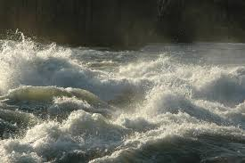
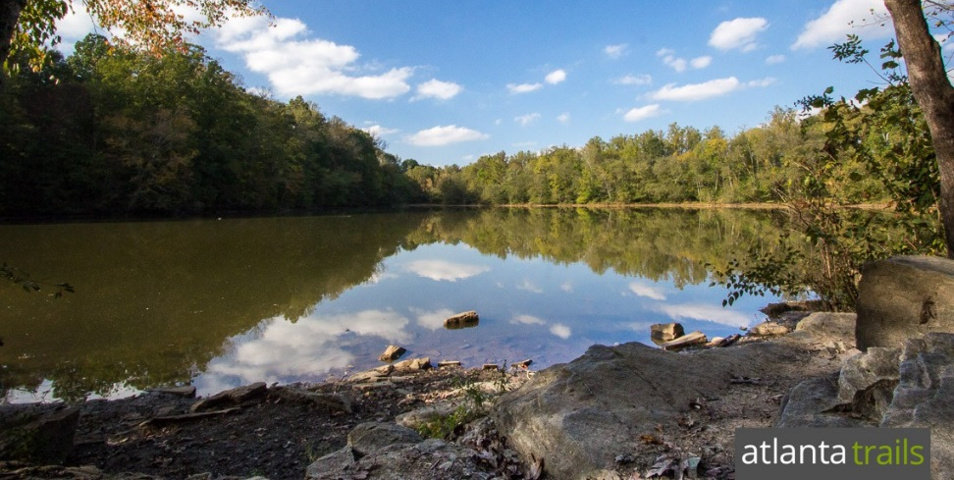
Rivers and Streams
Sediment- matter that settles to the bottom of a liquid
- naturally occurring materials that are broken down by
weathering and erosion
- as the slope levels, the water speed decreases and
sediments are deposited in the form of silt, mud and sand
Currents and turbulence of fast-moving rivers and streams prevent accumulation of sediment
------- prevents many species from living in these waters

Slide 44
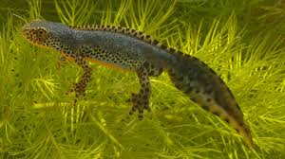
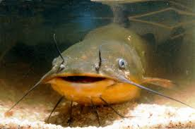
Rivers and Streams
All organisms that live in rivers and streams have the ability to withstand the constant water current
Plants that can root themselves into the streambed are common in areas where water is slowed by rocks or sandbars
Young fish hide in these plants and feed
on microscopic organisms floating by
Most organisms live in slow-moving waters where insect larvae are the primary food source

Slide 45
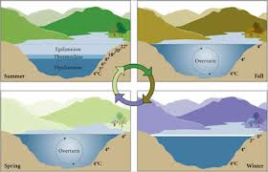
Lakes and Ponds
--an inland body of standing water
May be filled with water for only a few weeks a year or have existed for hundreds of years
Temperatures change depending on the season in temperate areas

Slide 46
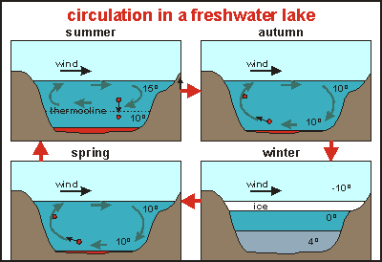
Lakes and Ponds
Temperatures change depending on the season in temperate areas

Slide 47
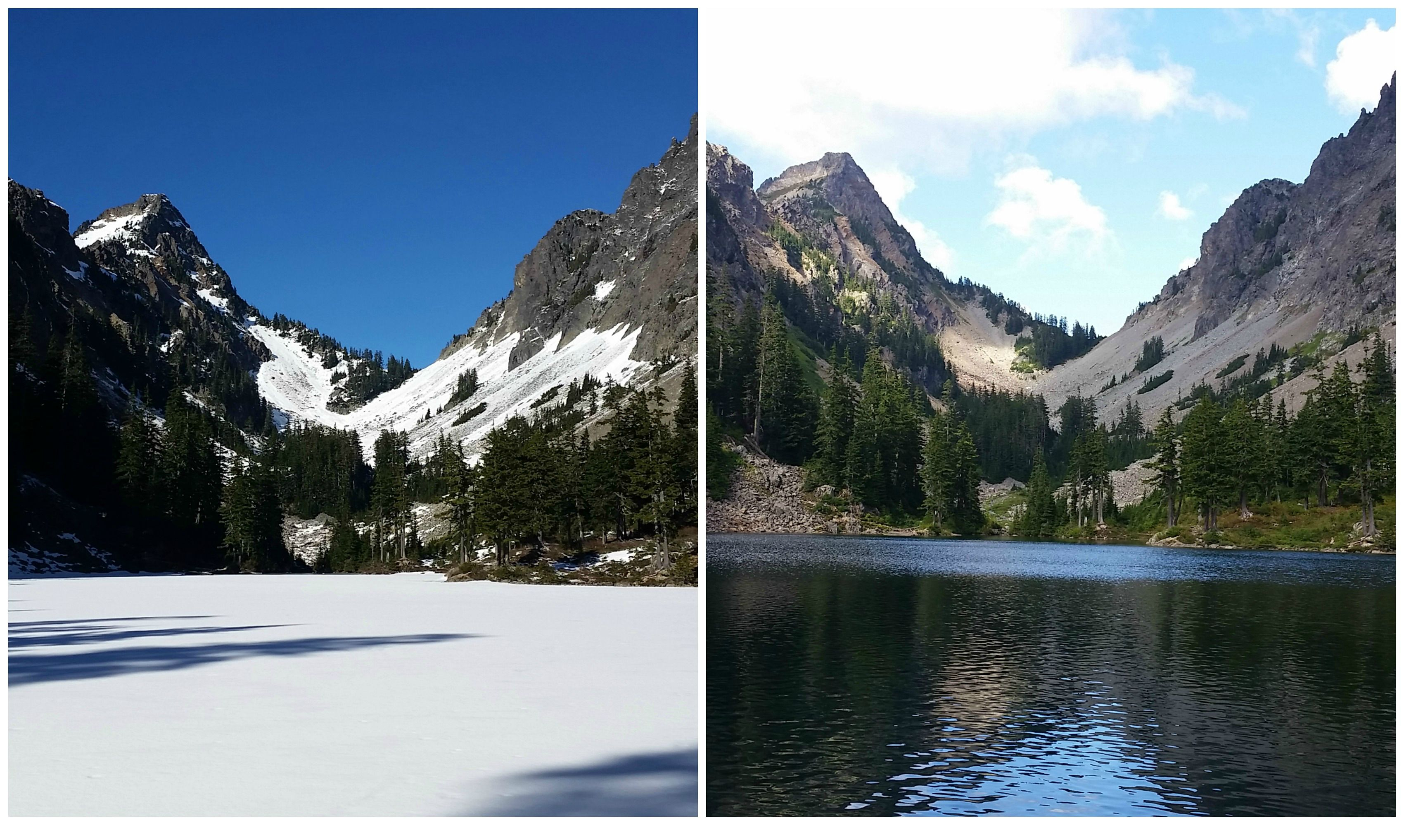
Lakes and Ponds
Winter- most of lake is same temperature with ice layer on top

Slide 48
Lakes and Ponds
Summer- warmer water sits on top with colder water at bottom

Slide 49
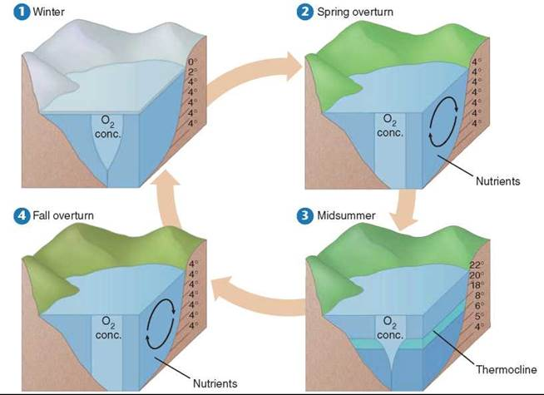
Spring and fall- turnover occurs as the warm water at the top cools and sinks
- mixing often occurs due to the winds
- results in uniform water temperature and circulates O² and brings up nutrients from the bottom to the surface

Slide 50
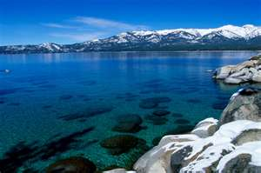
Lakes and Ponds
Oligotrophic lakes- nutrient-poor lakes
- found high on mountains
- troph= eat, nourish
- oligo= few

Slide 51
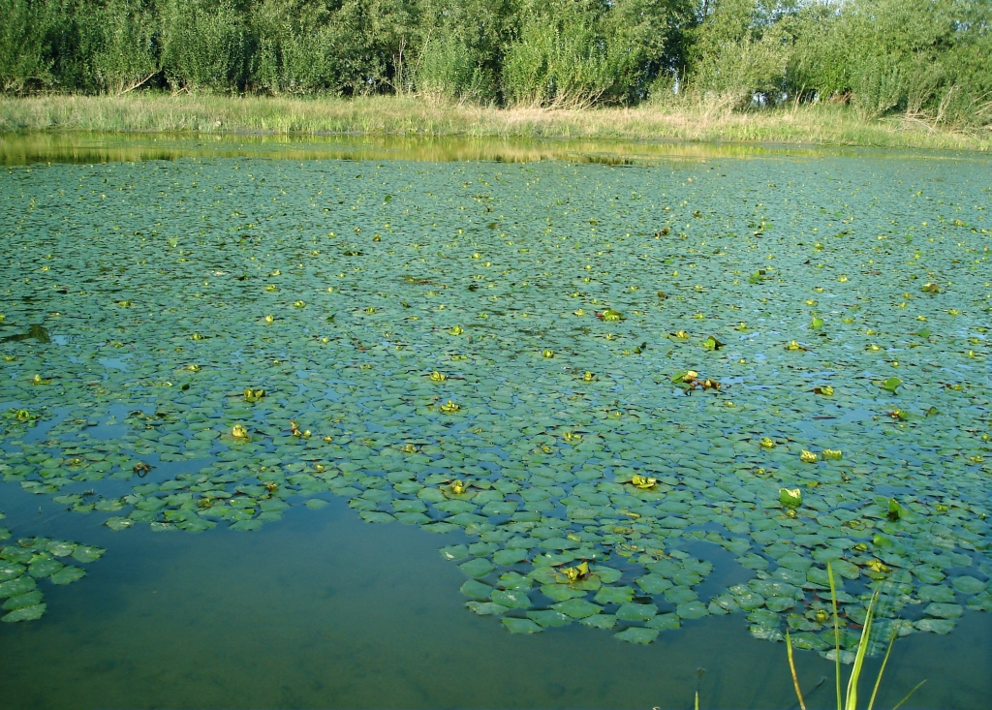
Lakes and Ponds
Eutrophic lakes- nutrient-rich lakes
- found at lower altitudes
- troph= eat, nourish
- eu= well

Slide 52
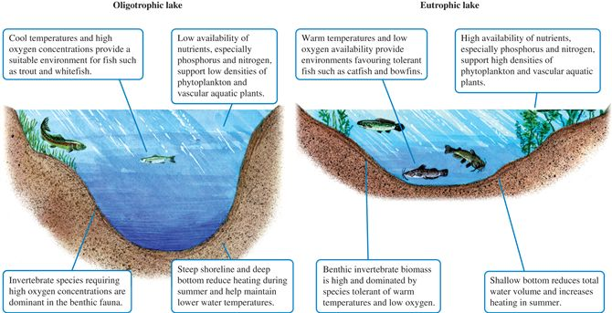

Slide 53
Divided into three zones based on the amount of light that penetrates the water

Slide 54
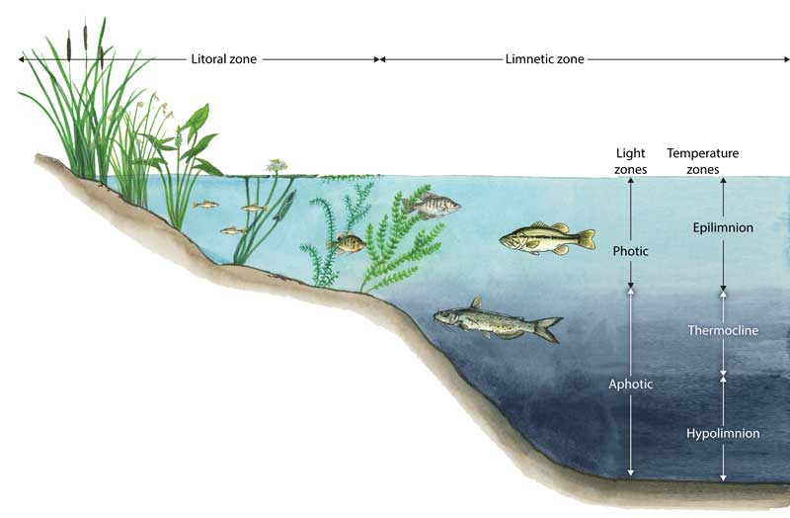

Slide 55
Aquatic Ecosystems Lakes and Ponds
Littoral zone- area closest to the shore
- water is shallow, allowing sunlight to reach the bottom
- most producers (plants and algae) live in this region, and
those consumers that feed on primary producers live here
Limnetic zone- open water area that is well lit and is dominated by plankton
Plankton are free-floating photosynthetic autotrophs
Many fish live in this region because of abundance of plankton for food

Slide 56
Profundal (benthic) zone- the deepest areas of a large lake with very little light penetration
- water is much colder and lower in O2 content
- low light penetration limits the number of species that can live
there
- no sunlight=no producers

Slide 57
Transitional aquatic ecosystems do not look like any of the other defined ecosystems
Are usually a combination of 2 or more different environments
Fresh and salt water intermingle or where land and water meet

Slide 58
Wetlands
Areas of land such as marshes, swamps and bogs that are saturated with water and support aquatic plants
Moist, humid environments
Bogs are wet and spongy areas of decomposing vegetation
High levels of species
diversity

Slide 59
Estuaries
Formed where freshwater from a river or stream merges with salt water from the ocean
- transitions in both fresh to salt water and
land to sea
- surpassed in biodiversity only by rain
forest and coral
reef ecosystems

Slide 60
Estuaries
Producers
Consumers
Algae, seaweeds and marsh grasses are primary producers
Salt marshes are similar to estuaries with salt-tolerant grasses dominating the landscape
Worms, oysters, crabs feed on detritus
Shrimp, marine fishes and invertebrates use estuaries as safe breeding grounds
Birds such as ducks and geese depend on estuaries for nesting, feeding and migration rest areas

Slide 61
Aquatic Ecosystems -Marine
Open ocean Ecosystem- extends from the intertidal zone to the deepest reaches of the oceans
Lowest area of productivity in an ocean
Due to varying levels of
sunlight

Slide 62
Aquatic Ecosystems Activity
On your Georgia map find and label ALL of the aquatic biomes in our state.
10 major rivers 1 Estuary
5 major lakes 1 Wetland
Use your internet resources to help
Use colors & create a map key

Slide 63
Aquatic Ecosystems Marine
Marine ecosystems have a significant impact on the environment
- photosynthesis by marine algae consume
CO2 from the air and produce over 50% of
the atmosphere’s O2
- evaporation from ocean water provides a
majority of the world’s precipitation
Separated into distinct zones, like lakes

Slide 64
Aquatic Ecosystems Marine
Intertidal Zone (littoral)- narrow band where the ocean meets the land
Organisms must be adapted to constant changes that occur daily as tides change and waves expose then submerge the shore
High area of productivity
Lots of sunlight
Many producers=more of food for
more organisms

Slide 65
Aquatic Ecosystems -Marine
Open ocean Ecosystem- extends from the intertidal zone to the deepest reaches of the oceans
Lowest area of productivity in an ocean
Due to varying levels of
sunlight

Slide 67
Aquatic Ecosystems Open Ocean
Pelagic zone- water neither close to the shore nor the bottom, from the surface to near the bottom
- pelagos- open sea
- conditions such as pressure, temperature and light
change with the changing depth
Photic zone- water that is exposed to enough sunlight to allow photosynthesis to occur (AKA euphotic zone)
- shallow enough for sunlight to penetrate- 200m deep
- autotrophic organisms include seaweed and plankton
- animals include jellyfish, dolphins, fish, turtles

Slide 68
Aquatic Ecosystems Open Ocean
Aphotic zone- area where sunlight is unable to penetrate
- constantly dark and generally cold (some thermal
layering occurs with mixing of ocean currents)
- Photosynthetic organism cannot survive here
Benthic zone- the area along the ocean floor that consists of sand, silt and dead organisms
- as depth increases, temperature drops, sunlight levels
decrease, O2 decreases
What happens to the amount of life in this zone?

Slide 69
Aquatic Ecosystems Open Ocean
Species diversity tends to decrease with water depth in oceans
Exceptions occur at the hydrothermal vents in the ocean floor
-tube worms, clams, crabs and
shrimp are adapted to live here
- strange organsims
Fish, octopus, squid live in the benthic zone

Slide 70
Aquatic Ecosystems Open Ocean
Abyssal zone- deepest regions of the ocean
- water is very cold
- organisms in this zone rely on food materials that drift
down from the zones above
- organisms are at the bottom of the food chain→ include
clams, crabs and some species of fish

Slide 71
To Review
Intertidal zone- band where ocean meets land, has 4 zones based on how much water it has in it (spray, high tide, mid tide and low tide)
Pelagic zone- majority of open water, from intertidal zone to open waters, has photic and aphotic zones
Benthic zone- area along the ocean floor
Abyssal zone- deepest regions of the ocean

Slide 72
Coral Reefs
Coral reefs are second on Earth in terms of biodiversity- what’s first?
Widely distributed in warm, shallow marine waters→ sunlight abundant
Form natural barriers along continents that protect the land from erosion
Coral has symbiotic relationship with specific species of algae→ algae provide food for corals, coral provide protection
and access to sunlight

Slide 73
Aquatic Ecosystems Coral Reefs
Organisms here include corals, algae, sea slugs, sea urchins, sea stars, many species of fish and microorganisms………
Coral reefs are very sensitive to changes in environment, especially temperature
Naturally occurring events can disrupt the ecosystem- tsunamis, hurricanes, human activity

