Slide 1
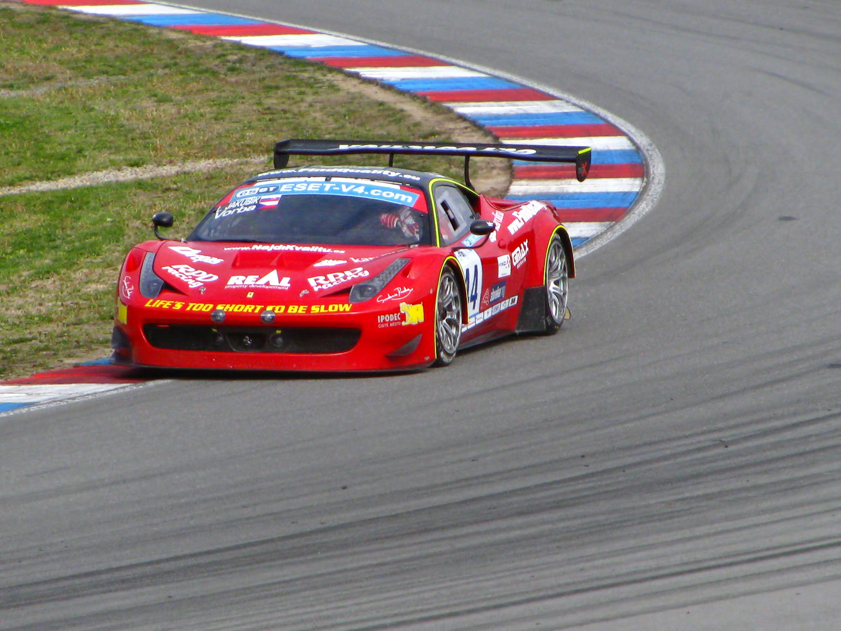
Unit 1: Velocity & Motion

Slide 2
Learning Target
Students will know the difference between scalar and vector quantities.
Students will be able to define velocity.

Slide 3
Describing Motion
Properties of motion:
Position
Frame of Reference
Distance
Direction
Displacement
Time
Speed
Velocity
Notes:
we cannot simply trust what we “see”
In order to describe motion of anything we need to measure some important properties

Slide 4
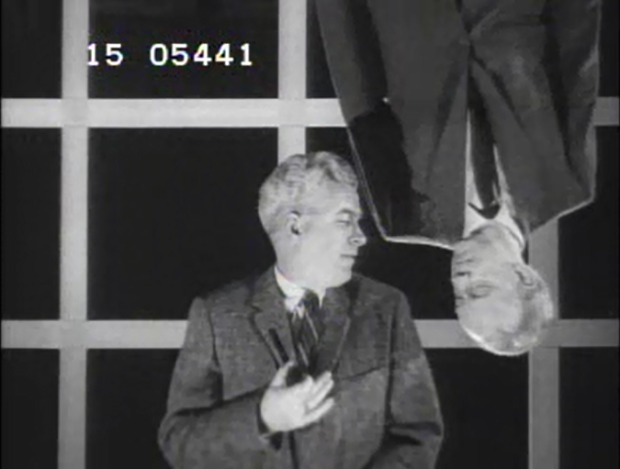
What is motion?
Frame of reference.
Who is upside down?
In order to see if something has moved, see if it has changed position.
Position: where an object is relative to a frame of reference.
Notes:
Motion is one of the key topics in physics.
Everything in universe moves. Maybe only a small amount of movement and very very slow, but movement does happen

Slide 5
Frame of reference
A point or set of points, assumed to be stationary, used as the “background” to describe motion.
Example:
You are sitting in a parked car in front of Target and the car next to you starts to back out of a parking space. For an instant you think you are moving. You look at the Target sign and realize you are not moving. The Target sign is your frame of reference.

Slide 6
Notes:
clip of barge

Slide 7
Notes:
Clip of rowers

Slide 8
Notes:
Clip of big bang

Slide 9
Scalar vs. Vector
(These are quantities!)
Scalar quantity
Has magnitude, (amount or size) only
EX: time, volume, speed, distance
Vector Quantity
Has magnitude and direction.
Shown with an arrow above it to imply it has direction.
EX: Velocity, distance, acceleration
Notes:
Scalar: quantity having only magnitude (ex: Time, volume, speed, distance)
Vector: Quantities that have both a magnitude and a direction

Slide 10
A vector quantity is something that has magnitude and a direction.
It is often shown with an arrow above it to imply it has direction.
Notes:
Click on image for short video
Vector = magnitude & direction
Ex: speed, distance, acceleration

Slide 11
Motion…
A change in position over time
Properties of motion:
Distance
Displacement
Speed
Velocity
This Photo by Unknown Author is licensed under CC BY-SA

Slide 12
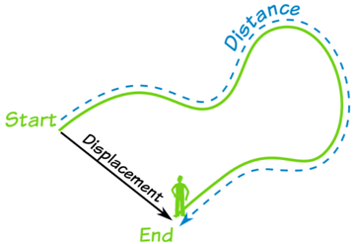
Distance:
A scalar quantity
“How much ground an object has covered”
during its’ motion.
Displacement:
A vector quantity
How far out of place an object has moved from it’s original position.
Measured using a straight line from one point to another and direction of movement.
Notes:
Scalar: quantity having only magnitude (ex: Time, volume, speed, distance)
Vector: Quantities that have both a magnitude and a direction

Slide 13
Speed
scalar quantity
“How fast an object is moving”
the ratio of distance over time. (time is the duration of an action or an event.)
v = d
t
A rate- a measure of how a quantity changes with respect to time.
Notes:
Think of speed as a type of rate.
When u are talking about motion u think of speed
Another way to look at motion is it’s speed

Slide 14
Velocity
Speed with direction
Complete description of motion @ a given time
Displacement covered over a given amount of time
v = d
t
Calculated same as speed
velocity will often be used in place of speed.

Slide 15
Average vs. Instantaneous speed
Average speed - a measure of speed calculated over the distance in a span of time.
(unless a range is specified)
Instantaneous speed - a measure of speed at any moment or point within the journey.
(think about a speedometer on a car!)
Could be a single set of x and y data points on a graph.
Total distance
Total time

Slide 16
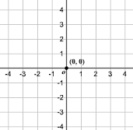
What if both points are moving? You and the frame of reference?
Relative velocity-the velocity of an object with respect to another observer.
-Calculates relative velocity of your moving object to the frame of reference.
v_{relative velocity} = v_{moving object}– V_{frame of reference}
Assign a direction to your motion
General rule:
East + West -
North + South -
Notes:
Equation to help determine your relative velocity with respect to a frame of reference.
Assign a direction to your motion.
Anything in that direction would be positive velocity, anything opposite to that direction would be negative velocity.
Same—Subtract
Opposite- add
It is rate of change of relative position of one object with respect to another object.

Slide 17
Practice!
Person A is in a car going 20 m/s E and passes Person B heading West at 0 m/s. What is Person’s A velocity relative to Person B?
Notes:
20 m/s E

Slide 18
Person A is in a car going 20 m/s E and passes Person B heading East at 10 m/s. What is Person’s A velocity relative to Person B?
Notes:
20 m/s – 10 m/s = 10 m/s

Slide 19
Person A is in a car going 20 m/s E and passes Person B heading West at 10 m/s. What is Person’s A velocity relative to Person B?
Notes:
20 m/s + 10 m/s = 30 m/s

